Slide 1










WIKIDATA & OPENREFINE
LinkedMusic Project Meeting II

Slide 2



2
Wikimedia 2023

Slide 3
WIKIDATA
Is a free and open knowledge base that can be read and edited by both humans and machines.
Wikidata acts as central storage for the structured data of its Wikimedia sister projects
But it also provides support beyond Wikimedia projects, as all the content is available under a free license, can be exported, and can be interlinked to other open data sets
3

Slide 4
WIKIPROJECT MUSIC
A WikiProject is a group of contributors who want to work together as a team to improve Wikidata. These groups often focus on a specific topic area or a specific kind of task.
Wikiproject Music is home to editors who help add data about artists, music releases, tracks, awards, and performances.
Additionally, importing from and linking Wikidata with the many music databases and streaming services is another focus of the project.
4

Slide 5
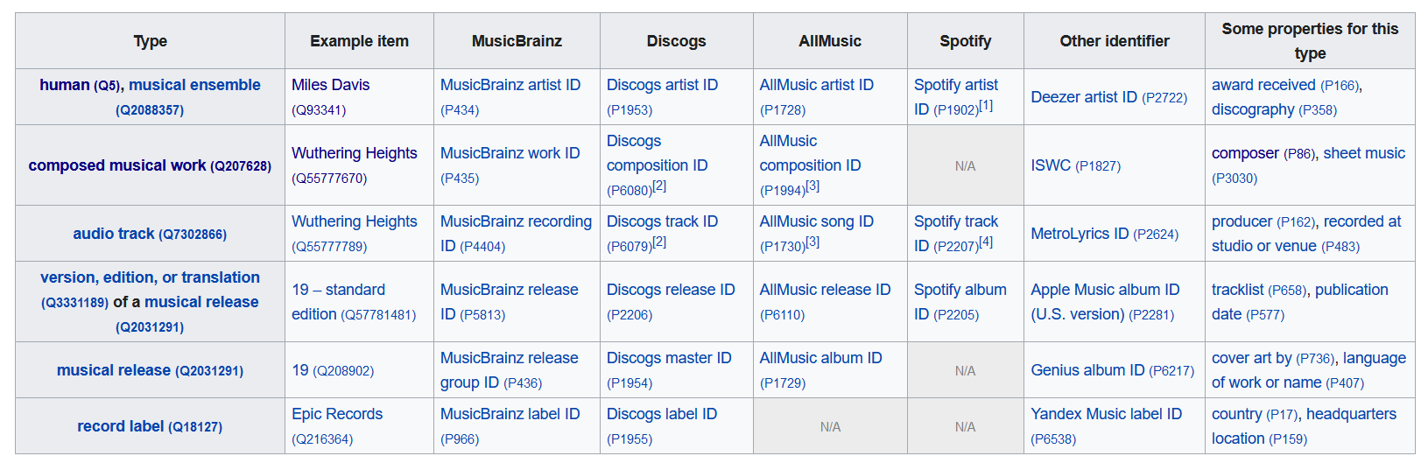
5
WikiProject Music 2023

Slide 6
QUERIES & STATISTICS
SPARQL QUERIES
List all composers
List all musical groups
WikiProject Music Statistics
Albums
EPs
Singles
Works
6
Notes:
575539 works in total

Slide 7
OPENREFINE
OpenRefine is a free, open-source tool for working with messy data. It works off of Java and a browser of your choice.
https://openrefine.org/docs
7

Slide 8
OPENREFINE USES
CLEANING
RECONCILLIATION
EXPRESSIONS
Trimming whitespace
Fixing data-type problems
Cluster editing
Matching your dataset with that of an external source.
Wikidata is built in, but you can add APIs for other datasets.
GREL (General Refine Expression Language)
Formulas use variables and depend on data types to do things like string manipulation or mathematical calculations:
8

Slide 9
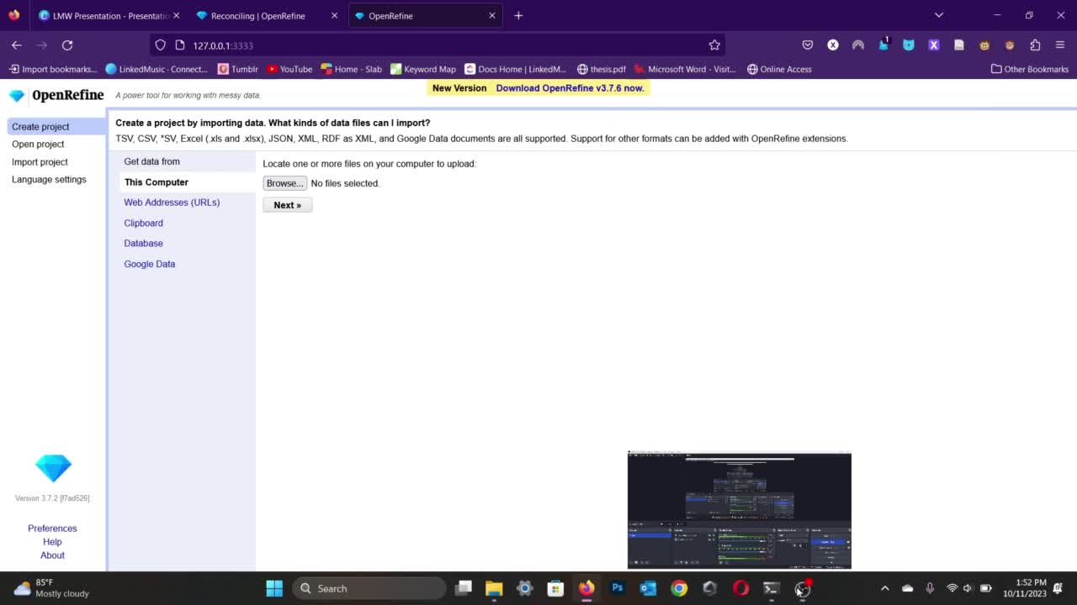
9

Slide 10


Thank you very much!

